Slide 1


CS-446: Information Systems Security
Chapter # 2: Introduction to Cryptography and Classical Cryptography
Prof. Dr. Sufian Hameed
Department of Computer Science
FAST-NUCES

Slide 2
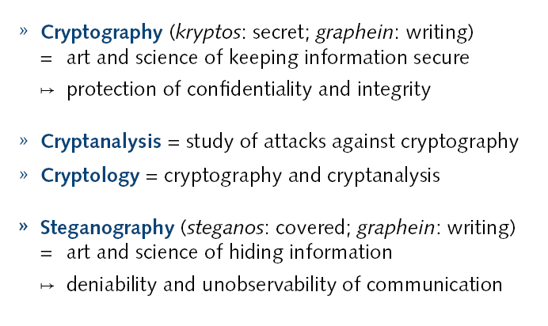
Cryptography

Slide 3
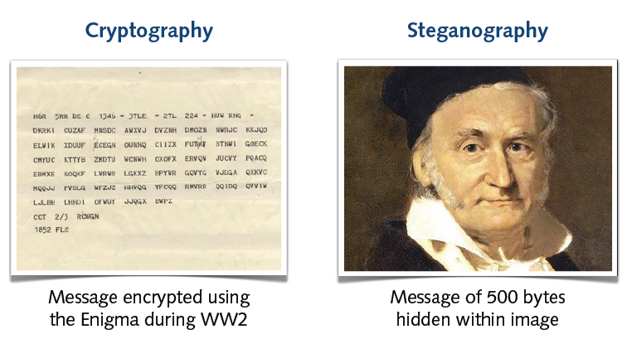
Examples

Slide 4
Cryptography
can characterize cryptographic system by:
type of encryption operations used
substitution
transposition
product
number of keys used
single-key or private
two-key or public
way in which plaintext is processed
block
stream
Notes:
Cryptographic systems can be characterized along these three independent dimensions.
The type of operations used for transforming plaintext to ciphertext. All encryption algorithms are based on two general principles: substitution, in which each element in the plaintext (bit, letter, group of bits or letters) is mapped into another element, and transposition, in which elements in the plaintext are rearranged. The fundamental requirement is that no information be lost (that is, that all operations are reversible). Most systems, referred to as product systems, involve multiple stages of substitutions and transpositions.
The number of keys used. If both sender and receiver use the same key, the system is referred to as symmetric, single-key, secret-key, or conventional encryption. If the sender and receiver use different keys, the system is referred to as asymmetric, two-key, or public-key encryption.
The way in which the plaintext is processed. A block cipher processes the input one block of elements at a time, producing an output block for each input block. A stream cipher processes the input elements continuously, producing output one element at a time, as it goes along.

Slide 5
Cryptographic systems can be characterized along these three independent dimensions.
The type of operations used for transforming plaintext to ciphertext. All encryption algorithms are based on two general principles:
substitution, in which each element in the plaintext (bit, letter, group of bits or letters) is mapped into another element.
and transposition, in which elements in the plaintext are rearranged. The fundamental requirement is that no information be lost (that is, that all operations are reversible). Most systems, referred to as product systems, involve multiple stages of substitutions and transpositions.
2.The number of keys used. If both sender and receiver use the same key, the system is referred to as symmetric, single-key, secret-key, or conventional encryption. If the sender and receiver use different keys, the system is referred to as asymmetric, two-key, or public-key encryption.
3.The way in which the plaintext is processed. A block cipher processes the input one block of elements at a time, producing an output block for each input block. A stream cipher processes the input elements continuously, producing output one element at a time, as it goes along.

Slide 6
Cryptanalysis
objective to recover key not just message
general approaches:
cryptanalytic attack
brute-force attack
if either succeed all key use compromised
Notes:
Typically objective is to recover the key in use rather then simply to recover the plaintext of a single ciphertext. There are two general approaches:
Cryptanalysis: relies on the nature of the algorithm plus perhaps some knowledge of the general characteristics of the plaintext or even some sample plaintext- ciphertext pairs. This type of attack exploits the characteristics of the algorithm to attempt to deduce a specific plaintext or to deduce the key being used.
Brute-force attacks try every possible key on a piece of ciphertext until an intelligible translation into plaintext is obtained. On average,half of all possible keys must be tried to achieve success.
If either type of attack succeeds in deducing the key, the effect is catastrophic: All future and past messages encrypted with that key are compromised.

Slide 7
Some Basic Terminology
plaintext - original message
ciphertext - coded message
cipher - algorithm for transforming plaintext to ciphertext
key - info used in cipher known only to sender/receiver
encipher (encrypt) - converting plaintext to ciphertext
decipher (decrypt) - recovering ciphertext from plaintext
cryptography - study of encryption principles/methods
cryptanalysis (codebreaking) - study of principles/ methods of deciphering ciphertext without knowing key
cryptology - field of both cryptography and cryptanalysis
Notes:
Briefly review some terminology used throughout the course.

Slide 8
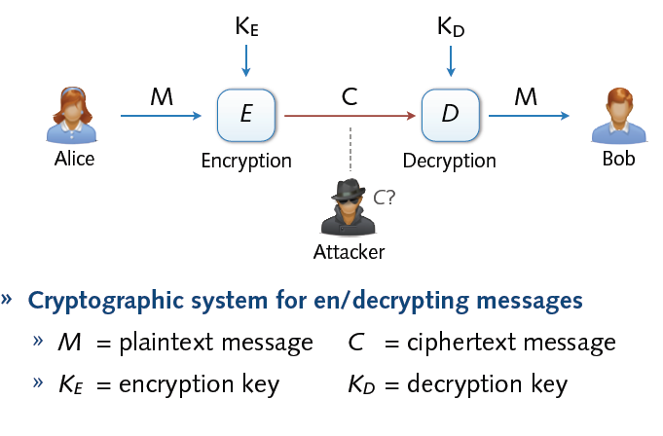
Cryptosystem

Slide 9
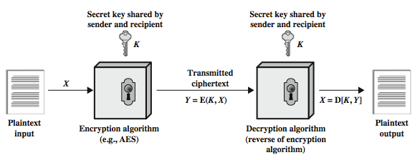
Symmetric Cipher Model
Notes:
Detail the five ingredients of the symmetric cipher model, shown in Stallings Figure 2.1:
plaintext - original message
encryption algorithm – performs substitutions/transformations on plaintext
secret key – control exact substitutions/transformations used in encryption algorithm
ciphertext - scrambled message
decryption algorithm – inverse of encryption algorithm

Slide 10
Requirements
two requirements for secure use of symmetric encryption:
a strong encryption algorithm
a secret key known only to sender / receiver
mathematically have:
Y = E(K, X)
X = D(K, Y)
assume encryption algorithm is known
implies a secure channel to distribute key
Notes:
There are two requirements for secure use of conventional encryption that mean we assume that it is impractical to decrypt a message on the basis of the cipher- text plus knowledge of the encryption/decryption algorithm, and hence do not need to keep the algorithm secret; rather we only need to keep the key secret. This feature of symmetric encryption is what makes it feasible for widespread use. It allows easy distribution of s/w and h/w implementations.
Can take a closer look at the essential elements of a symmetric encryption scheme: mathematically it can be considered a pair of functions with: plaintext X, ciphertext Y, key K, encryption algorithm E, decryption algorithm D. The intended receiver, in possession of the key, is able to invert the transformation. An opponent, observing Y but not having access to K or X, may attempt to recover X or K.

Slide 11
Attacks against Cryptosystems
1.) Cipher text-only: Attacker possesses a string y of the cipher text
2.) Known plaintext: Attacker possesses a string x of the plaintext and the corresponding cipher text y. The problem now is to find out the key which produces y from x
3.) Chosen plaintext: Attacker has access to the encryption machinery. Hence he can chose a plaintext string x and construct the corresponding cipher text string y.
4.) Chosen cipher text: Attacker has access to the decryption machinery. Hence, he can chose a cipher text string y and construct the corresponding plaintext string x.

Slide 12
Brute Force Search
always possible to simply try every key
most basic attack, proportional to key size
assume either know / recognise plaintext
Key Size (bits) | Number of Alternative Keys | Time required at 1 decryption/µs | Time required at 10⁶ decryptions/µs
32 | 2³² = 4.3 × 10⁹ | 2³¹ µs = 35.8 minutes | 2.15 milliseconds
56 | 2⁵⁶ = 7.2 × 10¹⁶ | 2⁵⁵ µs = 1142 years | 10.01 hours
128 | 2¹²⁸ = 3.4 × 10³⁸ | 2¹²⁷ µs = 5.4 × 10²⁴ years | 5.4 × 10¹⁸ years
168 | 2¹⁶⁸ = 3.7 × 10⁵⁰ | 2¹⁶⁷ µs = 5.9 × 10³⁶ years | 5.9 × 10³⁰ years
26 characters (permutation) | 26! = 4 × 10²⁶ | 2 × 10²⁶ µs = 6.4 × 10¹² years | 6.4 × 10⁶ years
Notes:
A brute-force attack involves trying every possible key until an intelligible translation of the ciphertext into plaintext is obtained. On average, half of all possible keys must be tried to achieve success. Stallings Table 2.2 shows how much time is required to conduct a brute-force attack, for various common key sizes (DES is 56, AES is 128, Triple-DES is 168, plus general mono-alphabetic cipher), where either a single system or a million parallel systems, are used.

Slide 13
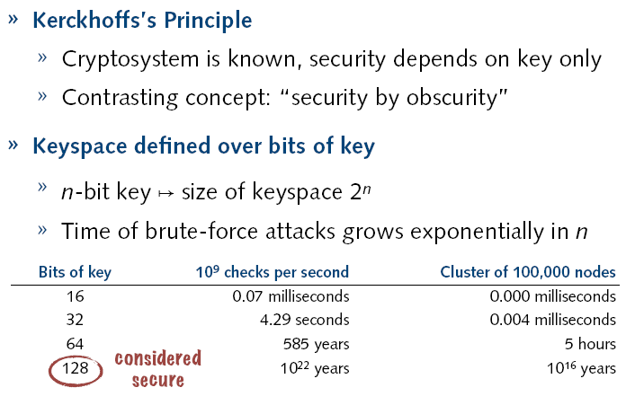
Security of Keys

Slide 14
An encryption scheme: computationally secure if
The cost of breaking the cipher exceeds the value of information
The time required to break the cipher exceeds the lifetime of information

Slide 15
Cryptography is everywhere
Secure communication:
web traffic: HTTPS
wireless traffic: 802.11i WPA2 (and WEP), GSM, Bluetooth
Encrypting files on disk:
EFS (Encrypting File System)
TrueCrypt (open-source disk encryption software)
Content protection
DVD --- Content Scramble System (CSS) is a Digital Rights Management (DRM) and encryption system employed on almost all commercially produced DVD-Video
Easy to break
Blu-Ray --- Advance Access Content System (AACS)
User authentication
… and much much more

Slide 16
Things to remember
Cryptography is:
A tremendous tool
The basis for many security mechanisms
Cryptography is not:
The solution to all security problems
Software bugs
Social engineering attacks
Reliable unless implemented and used properly
Wired Equivalent Privacy (WEP -- good example on how not to use cryptography)
Something you should try to invent yourself
many examples of broken ad-hoc designs
Propriety ciphers, once re-engineered are easily broken

Slide 17
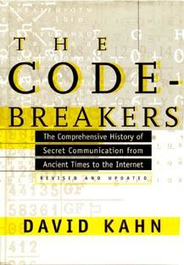
History
The Codebreakers – The Story of Secret Writing (ISBN 0-684-83130-9) is a book by David Kahn, published in 1967, comprehensively chronicling the history of cryptography from ancient Egypt to the time of its writing. The United States government attempted to have the book altered before publication, and it succeeded in part
David Kahn, “The code breakers” (1996)

Slide 18
Historical Cryptosystems
Monoalphabetic cipher: Each alphabetic character is mapped onto a unique alphabetic character
Examples: Shift Cipher, Substitution Cipher, Affine Cipher
Polyalphabetic cipher: Each alphabetic character is mapped onto various alphabetic characters
Examples: Vigenere Cipher, Hill Cipher, Permutation Cipher

Slide 19
Symmetric Cryptosystems
Formal Definition:
Cryptosystem is defined over (K,M,C) and a pair of “efficient” algorithms (E, D) s.t.
∀ m∈M, k∈K and c∈C : E(k, m) = c, D(k, E(k, m) ) = m
Efficient means run in polynomial time
Notes:
Picture of cipher

Slide 20
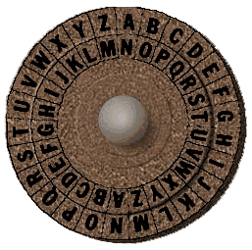
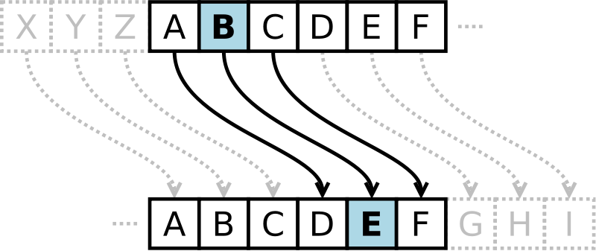
Shift Cipher
Cipher in which each letter in the plaintext is replaced by a letter some fixed number of positions down the alphabet. Example includes Ceasar cipher, ROT13
Ceasar Cipher
Each letter is replaced with a fixed shift of 3 letters
Example of Ceasar cipher using left rotation of 3 places
Plain: ABCDEFGHIJKLMNOPQRSTUVWXYZ
Cipher: DEFGHIJKLMNOPQRSTUVWXYZABC
Source: wikipedia

Slide 21
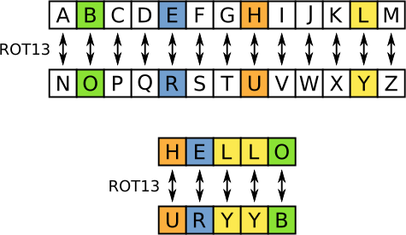
Shift Cipher (ROT13)
ROT13
Each letter is replaced with a fixed shift of 13 letters
The transformation can be done as follows
Plain: ABCDEFGHIJKLMNOPQRSTUVWXYZ
Cipher: NOPQRSTUVWXYZABCDEFGHIJKLM
Modular arithmetic representation:
Encryption of a letter x by a shift n can be described mathematically as
E_{n}(x) = (x+n) mod 26
Decryption is performed in a similar manner
D_{n}(x) = (x-n) mod 26
Key space is ridiculously small, very easy to break
Source: wikipedia

Slide 22
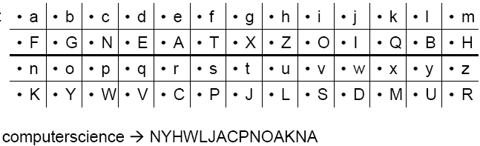
Substitution Cipher
Idea: use a permutation over the set of characters as key to get a more flexible scheme as in the shift cipher
Keyspace significantly larger
Character frequencies are preserved

Slide 23




What is the size of key space in the substitution cipher assuming 26 letters?
$$|\text{𝒦}\text{| = 26}$$
$\left|𝒦\right|=26! ($26 factorial)
$$|\text{𝒦}\text{| = }2^{26}$$
$$|\text{𝒦}\text{| = }{26}^{2}$$

Slide 24
Monogram, Bigram and Trigram frequency counts
Introduction to Frequency Analysis
Frequency analysis is the practice of counting the number of occurances of different ciphertext characters in the hope that the information can be used to break ciphers. Frequency analysis is not only for single characters, it is also possible to measure the frequency of bigrams (also called digraphs), which is how often pairs of characters occur in text. Trigram frequency counts measure the ocurrance of 3 letter combinations.
When talking about bigram and trigram frequency counts, this page will concentrate on text characterisation as opposed to solving polygraphic ciphers e.g. playfair. The difference is that text characterisation depends on all possible 2 character combinations, since we wish to know about as many bigrams as we can (this means we allow the bigrams to overlap). When cracking playfair, we do not allow the bigrams to overlap.
http://practicalcryptography.com/cryptanalysis/text-characterisation/monogram-bigram-and-trigram-frequency-counts/

Slide 25
English Letter Frequencies
The frequencies from this page are generated from around 4.5 billion characters of English text, sourced from Wortschatz. The text files containing the counts can be used with ngram_score.py and used for breaking ciphers, see this page for details. If you want to compute the letter frequencies of your own piece of text you can use this page.
Monogram Frequencies
English single letter frequencies are as follows (in percent %):
A : 8.55 K : 0.81 U : 2.68
B : 1.60 L : 4.21 V : 1.06
C : 3.16 M : 2.53 W : 1.83
D : 3.87 N : 7.17 X : 0.19
E : 12.10 O : 7.47 Y : 1.72
F : 2.18 P : 2.07 Z : 0.11
G : 2.09 Q : 0.10
H : 4.96 R : 6.33
I : 7.33 S : 6.73
J : 0.22 T : 8.94

Slide 26
Common English Words §
The following words are the most common words in a 'news' text corpus containing around 900 Million words. The numbers represent percent of occurance, i.e. 'THE' constitutes aroung 6.42% of all words.
THE : 6.42 ON : 0.78 ARE : 0.47
OF : 2.76 WITH : 0.75 THIS : 0.42
AND : 2.75 HE : 0.75 I : 0.41
TO : 2.67 IT : 0.74 BUT : 0.40
A : 2.43 AS : 0.71 HAVE : 0.39
IN : 2.31 AT : 0.58 AN : 0.37
IS : 1.12 HIS : 0.55 HAS : 0.35
FOR : 1.01 BY : 0.51 NOT : 0.34
THAT : 0.92 BE : 0.48 THEY : 0.33
WAS : 0.88 FROM : 0.47 OR : 0.30

Slide 27
Bigram Frequencies
A.k.a digraphs. We can't list all of the bigram frequencies here, the top 30 are the following (in percent %):
TH : 2.71 EN : 1.13 NG : 0.89
HE : 2.33 AT : 1.12 AL : 0.88
IN : 2.03 ED : 1.08 IT : 0.88
ER : 1.78 ND : 1.07 AS : 0.87
AN : 1.61 TO : 1.07 IS : 0.86
RE : 1.41 OR : 1.06 HA : 0.83
ES : 1.32 EA : 1.00 ET : 0.76
ON : 1.32 TI : 0.99 SE : 0.73
ST : 1.25 AR : 0.98 OU : 0.72
NT : 1.17 TE : 0.98 OF : 0.71

Slide 28
Trigram Frequencies
A.k.a trigraphs. We can't list all of the trigram frequencies here, the top 30 are the following (in percent %):
THE : 1.81 ERE : 0.31 HES : 0.24
AND : 0.73 TIO : 0.31 VER : 0.24
ING : 0.72 TER : 0.30 HIS : 0.24
ENT : 0.42 EST : 0.28 OFT : 0.22
ION : 0.42 ERS : 0.28 ITH : 0.21
HER : 0.36 ATI : 0.26 FTH : 0.21
FOR : 0.34 HAT : 0.26 STH : 0.21
THA : 0.33 ATE : 0.25 OTH : 0.21
NTH : 0.33 ALL : 0.25 RES : 0.21
INT : 0.32 ETH : 0.24 ONT : 0.20

Slide 29
Must see below link for frequency info
http://practicalcryptography.com/cryptanalysis/letter-frequencies-various-languages/english-letter-frequencies/

Slide 30
Breaking Monoalphabetic Ciphers
Monoalphabetic ciphers preserve the frequency of alphabetic characters, pairs, etc.
→ Identify alphabetic characters due to their frequency
Method to decipher natural languages:
Determine frequency of alphabetic characters of the cipher text
Identify alphabetic characters according to their frequency: e, n, i, s, r, a, t (in Germany: e, n, r, i, s, t, u, d, a, g, l, o, ...)
Determine frequency of pairs
Identify e.g. th he
Look at identified text, re-substitute, guess, ...

Slide 31
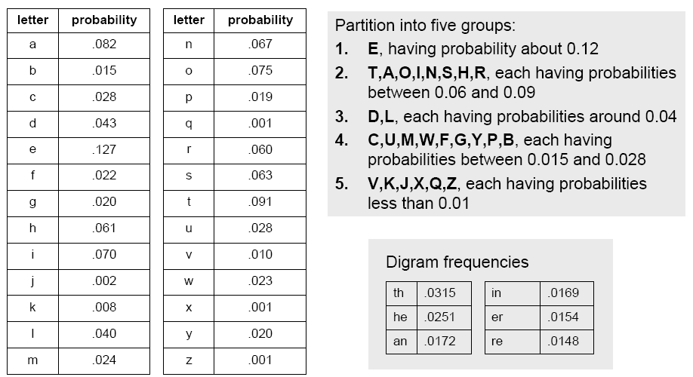
Breaking Monoalphabetic Ciphers

Slide 32
One of the main problems with simple substitution ciphers is that they are so vulnerable to frequency analysis.
Given a sufficiently large ciphertext, it can easily be broken by mapping the frequency of its letters to the know frequencies of, say, English text. Therefore, to make ciphers more secure, cryptographers have long been interested in developing enciphering techniques that are immune to frequency analysis. One of the most common approaches is to suppress the normal frequency data by using more than one alphabet to encrypt the message.
A polyalphabetic substitution cipher involves the use of two or more cipher alphabets. Instead of there being a one-to-one relationship between each letter and its substitute, there is a one-to-many relationship between each letter and its substitutes.

Slide 33
The Vigenere Cipher, proposed by Blaise de Vigenere from the court of Henry III of France in the sixteenth century, is a polyalphabetic substitution based on the following tableau.

Slide 34
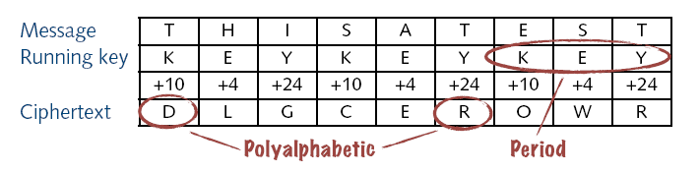
Vigenere Cipher
Popular polyalphabetic substitution cipher
Known as “le chiffre indéchiffrable” (‘the indecipherable cipher’ );-)
Combination of simple substitution ciphers
Rotations determined by a word (key)
A B C D E F G H I J K L M N O P Q R S T U V W X Y Z
0 1 2 3 4 5 6 7 8 9 10 11 12 13 14 15 16 17 18 19 20 21 22 23 24 25

Slide 35
A B C D E F G H I J K L M N O P Q R S T U V W X Y Z
B C D E F G H I J K L M N O P Q R S T U V W X Y Z A
C D E F G H I J K L M N O P Q R S T U V W X Y Z A B
D E F G H I J K L M N O P Q R S T U V W X Y Z A B C
E F G H I J K L M N O P Q R S T U V W X Y Z A B C D
F G H I J K L M N O P Q R S T U V W X Y Z A B C D E
G H I J K L M N O P Q R S T U V W X Y Z A B C D E F
H I J K L M N O P Q R S T U V W X Y Z A B C D E F G
I J K L M N O P Q R S T U V W X Y Z A B C D E F G H
J K L M N O P Q R S T U V W X Y Z A B C D E F G H I
K L M N O P Q R S T U V W X Y Z A B C D E F G H I J
L M N O P Q R S T U V W X Y Z A B C D E F G H I J K
M N O P Q R S T U V W X Y Z A B C D E F G H I J K L
N O P Q R S T U V W X Y Z A B C D E F G H I J K L M
O P Q R S T U V W X Y Z A B C D E F G H I J K L M N
P Q R S T U V W X Y Z A B C D E F G H I J K L M N O
Q R S T U V W X Y Z A B C D E F G H I J K L M N O P
R S T U V W X Y Z A B C D E F G H I J K L M N O P Q
S T U V W X Y Z A B C D E F G H I J K L M N O P Q R
T U V W X Y Z A B C D E F G H I J K L M N O P Q R S
U V W X Y Z A B C D E F G H I J K L M N O P Q R S T
V W X Y Z A B C D E F G H I J K L M N O P Q R S T U
W X Y Z A B C D E F G H I J K L M N O P Q R S T U V
X Y Z A B C D E F G H I J K L M N O P Q R S T U V W
Y Z A B C D E F G H I J K L M N O P Q R S T U V W X
Z A B C D E F G H I J K L M N O P Q R S T U V W X Y
SAVEMEPLEASE plain text
CRYPTOGRAMCR keyword
URTTFSVCEMUV enciphered
The first letter, S is encrypted using the row beginning with C
The second letter, A is encryted using the row beginning with R
The third letter, V is encrypted using the row beginning with Y
The fourth letter, E, is encrypted using the row beginning with P.
And so on . . .
You can use http://www.simonsingh.net/The_Black_Chamber/v_square.html

Slide 36
Security of Vigenere Cipher
Vigenere masks the frequency with which a character appears in a language: one letter in the ciphertext corresponds to multiple letters in the plaintext. Makes the use of frequency analysis more difficult.
Any message encrypted
by a Vigenere cipher is a
collection of as many shift ciphers as there
are letters in the key.

Slide 37
Vigenere Cipher: Cryptanalysis
Find the length of the key.
Divide the message into that many simple substitution encryptions.
Solve the resulting simple substitutions.
how?
Notes:
Vigenere-like substitution ciphers were regarded by many as practically unbreakable for 300 years. In 1863, a Prussian major named Kasiski proposed a method for breaking a Vigenere cipher that consisted of finding the length of the keyword and then dividing the message into that many simple substitution cryptograms. Frequency analysis could then be used to solve the resulting simple substitutions.

Slide 38
Vigenere-like substitution ciphers were regarded by many as practically unbreakable for 300 years. In 1863, a Prussian major named Kasiski proposed a method for breaking a Vigenere cipher that consisted of finding the length of the keyword and then dividing the message into that many simple substitution cryptograms. Frequency analysis could then be used to solve the resulting simple substitutions.

Slide 39
Breaking Vigenere Cipher
Frequency analysis trivial if period can be guessed
Kasiski test
Repeated words may, by chance, sometimes be encrypted using the same key letters, leading to repeated groups in the ciphertext
Consider the following encryption using the keyword ABCD
Key: ABCD ABCD ABCD ABCD ABCD ABCD ABCD
Plaintext: CRYP TOIS SHOR TFOR CRYP TOGR APHY
Ciphertext: CSAS TPKV SIQU TGQU CSAS TPIU AQJB
Repetitions of CSASTP is at a distance16
Assuming that the repeated segments represent the same plaintext segments, this implies that the key is 16, 8, 4, 2, or 1 characters long
Source: wikipedia

Slide 40
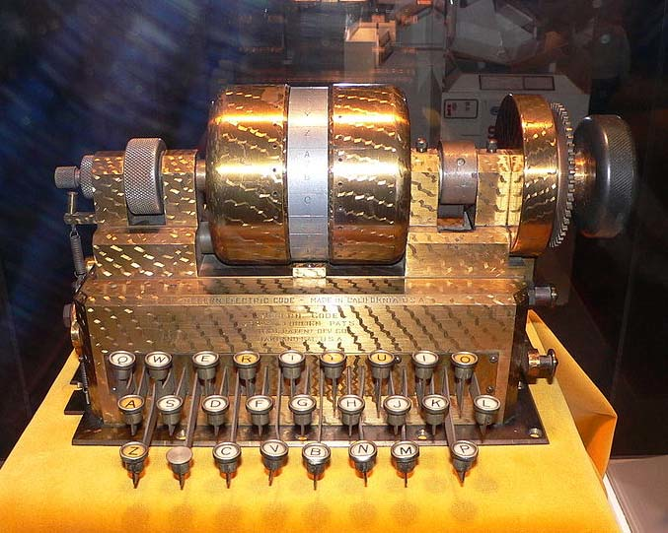
Rotor Machines (1870-1943)
The Hebern Machine (single rotor)
Easily broken (CT only) using letter frequency, diagram frequency, trigram frequency
A
B
C
.
.
X
Y
Z
K
S
T
.
.
R
N
E
E
K
S
T
.
.
R
N
N
E
K
S
T
.
.
R
key

Slide 41
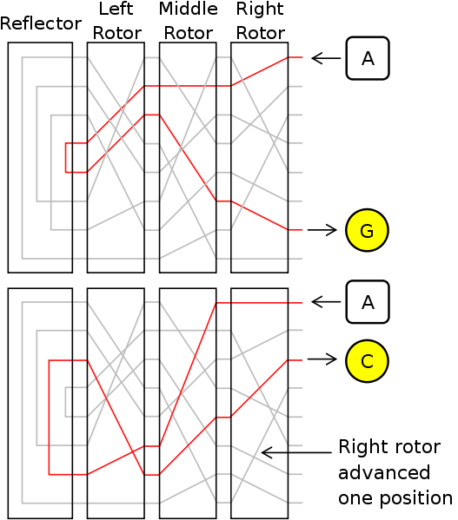
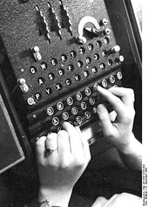
Rotor Machines (cont.)
Most famous: the Enigma (3-5 rotors)
With 4 rotors keys = 26⁴ = 2¹⁸ (actually 2³⁶ due to optional plugboard)

Slide 42
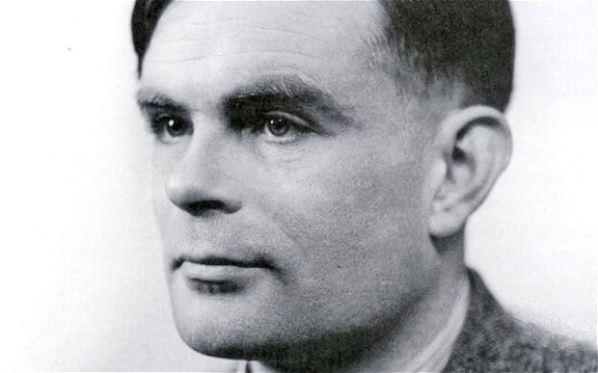
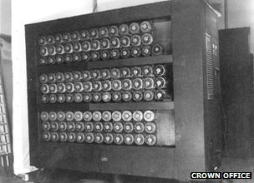
Turing Bombe

Slide 43
Must watch
“The Man Who Cracked Enigma”

Slide 44
Acknowledgements
Material in this lecture are taken from the slides prepared by:
Prof. Dr. Konrad Rieck (Uni-Göttingen)
Prof. Dan Boneh (Stanford)

